Slide 1
Zero Trust w chmurze Microsoft
Konrad Sagała – cloud security architect

Slide 2
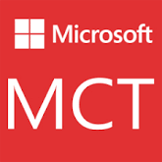


About Me
Cloud Security Architect
Microsoft Certified Trainer
Microsoft MVP since 2007 – M365 Apps & Services
Blog – https://pepugmaster.blogspot.com
Twitter - @sagus
Github - https://github.com/ksagala

Slide 3
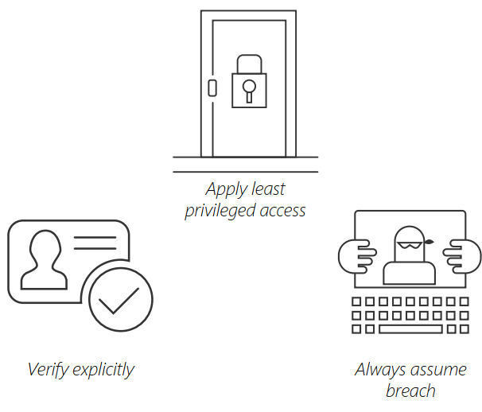
Microsoft Zero Trust Principles Guidance for technical architecture
Notes:
Verify explicitly - Always validate all available data points including
User identity and location
Device health
Service or workload context
Data classification
Anomalies
To help secure both data and productivity, limit user access using
Just-in-time (JIT)
Just-enough-access (JEA)
Risk-based adaptive polices
Data protection against out of band vectors
Assume breach - Minimize blast radius for breaches and prevent lateral movement by
Segmenting access by network, user, devices, and app awareness.
Encrypting all sessions end to end.
Use analytics for threat detection, posture visibility and improving defenses

Slide 4



Microsoft Zero Trust Principles Guidance for technical architecture
Verify explicitly
Use least privilege access
Assume breach
Always validate all available data points including
User identity and location
Device health
Service or workload context
Data classification
Anomalies
To help secure both data and productivity, limit user access using
Just-in-time (JIT)
Just-enough-access (JEA)
Risk-based adaptive polices
Data protection against out of band vectors
Minimize blast radius for breaches and prevent lateral movement by
Segmenting access by network, user, devices, and app awareness.
Encrypting all sessions end to end.
Use analytics for threat detection, posture visibility and improving defenses
Notes:
Key Takeaway: These are Microsoft’s Zero Trust Principles

Slide 5
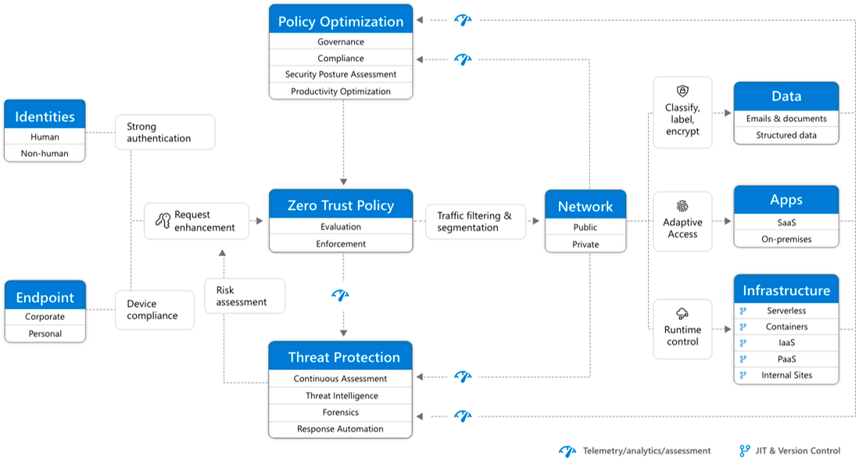

Slide 6
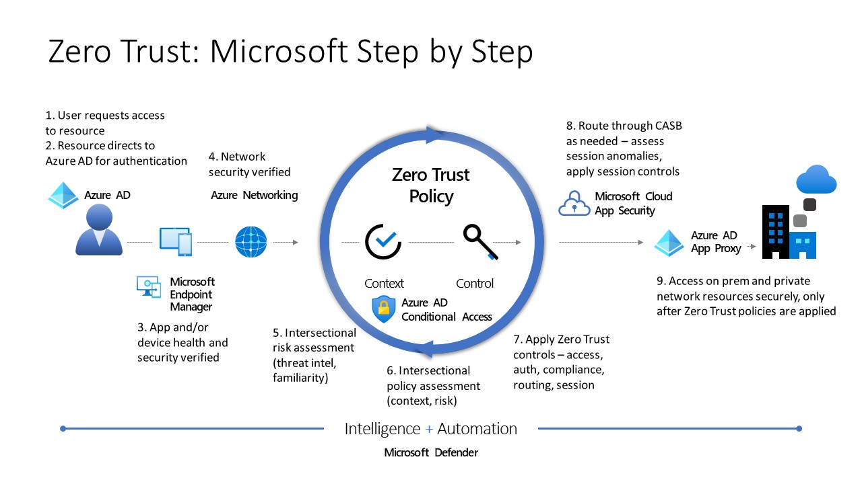

Slide 7
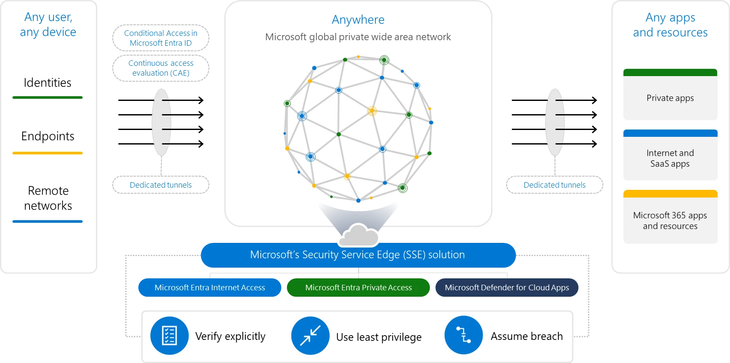

Slide 8












Microsoft Zero Trust Capabilities
Posture Management
Identities
Applications
Continuous risk assessment & Automation
Microsoft Defender for Cloud
Microsoft Azure AD
Conditional Access
Threat intelligence & Telemetry
Data
Zero Trust policy enforcement
Microsoft Defender for Identity
Microsoft Information Protection
Azure Active Directory (Azure AD)
Infrastructure
Endpoints
Microsoft Conditional Access
Azure AD B2B & B2C
Microsoft Defender
Microsoft Defender for Cloud Apps
Network
Microsoft Endpoint Manager
Microsoft Sentinel
Notes:
Key Takeaway: This is a summary of how Microsoft technologies work together to apply Zero Trust principles to Access Control

Slide 9

Key Zero Trust Resources to help you on your Zero Trust journey
Zero Trust Resources
aka.ms/zerotrust
Maturity Model
aka.ms/zerotrust
Business Plan
aka.ms/ztbizplan
Deployment Guidance
aka.ms/ztguide
Zero Trust: Security Through a Clearer Lens session (Recording | Slides)
CISO Workshop Slides/Videos
Microsoft’s IT Learnings from (ongoing) Zero Trust journey
Notes:
Key Takeaway: Use these resources to learn more about Zero Trust and how Microsoft capabilities can enable it (often using technology that’s already deployed)

